Slide 1
Gradient Descent, Logistic Regression
Vivek Dixit

Slide 3
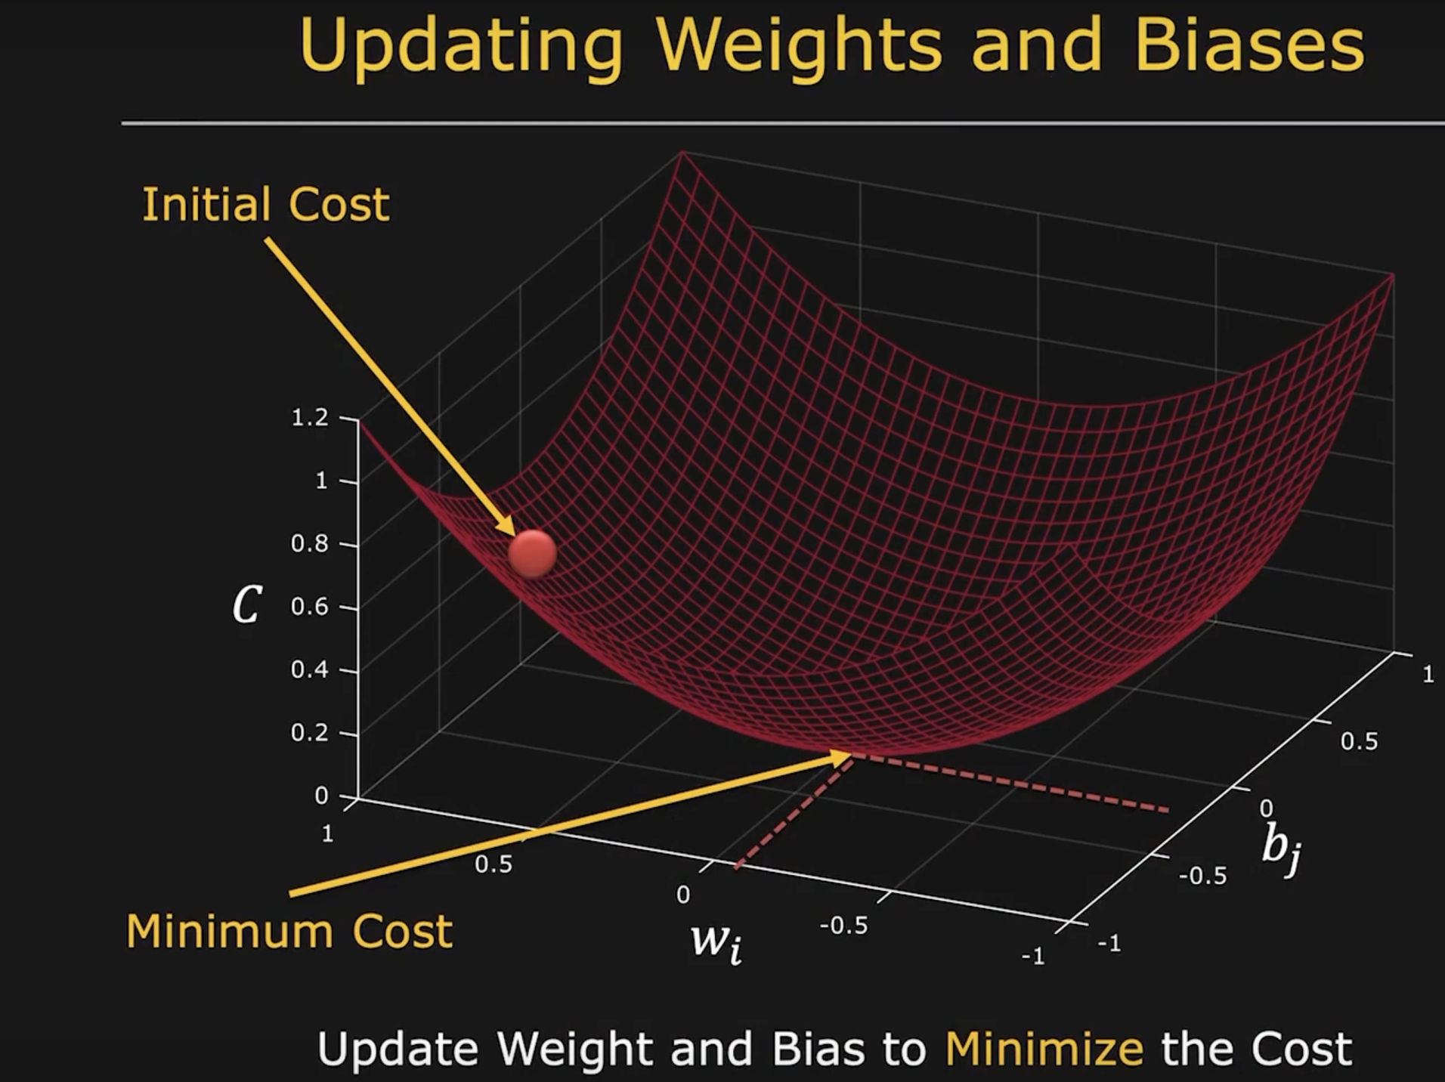
Gradient Descent

Slide 4
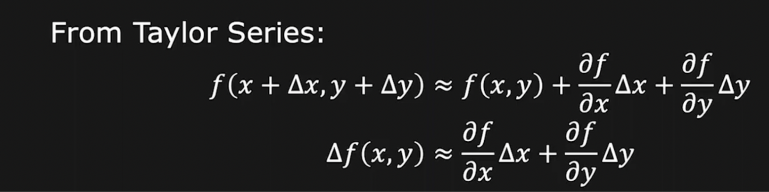
Change in Cost

Slide 5
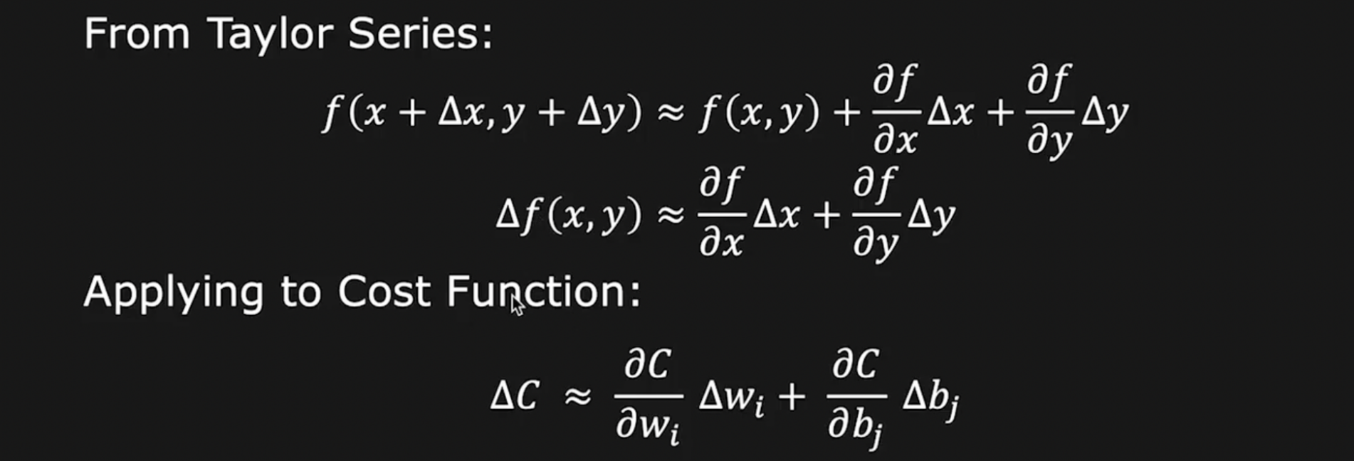
Change in Cost

Slide 6
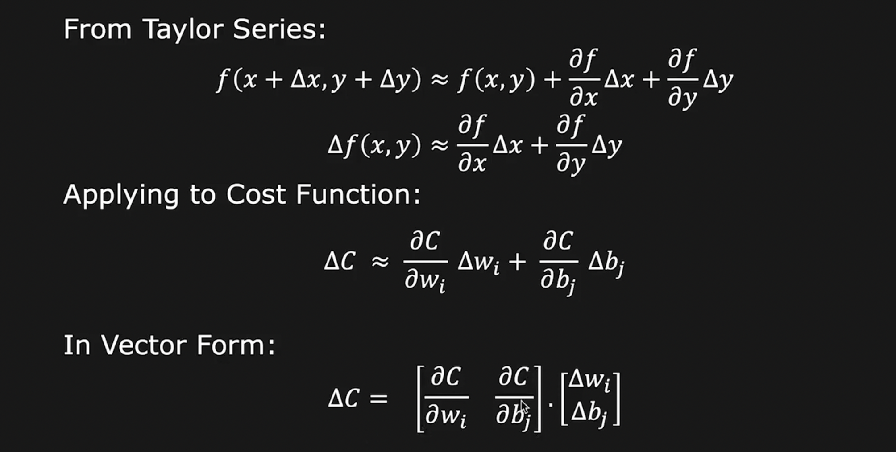
Change in Cost

Slide 7
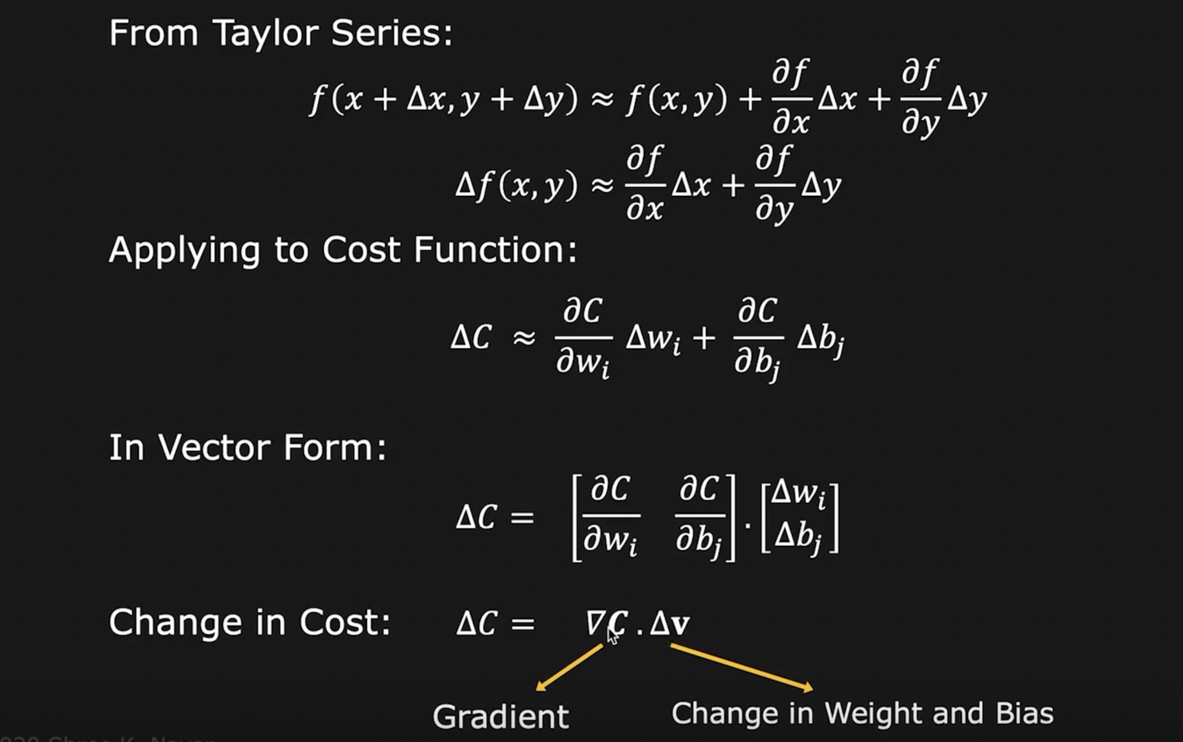
Change in Cost

Slide 8
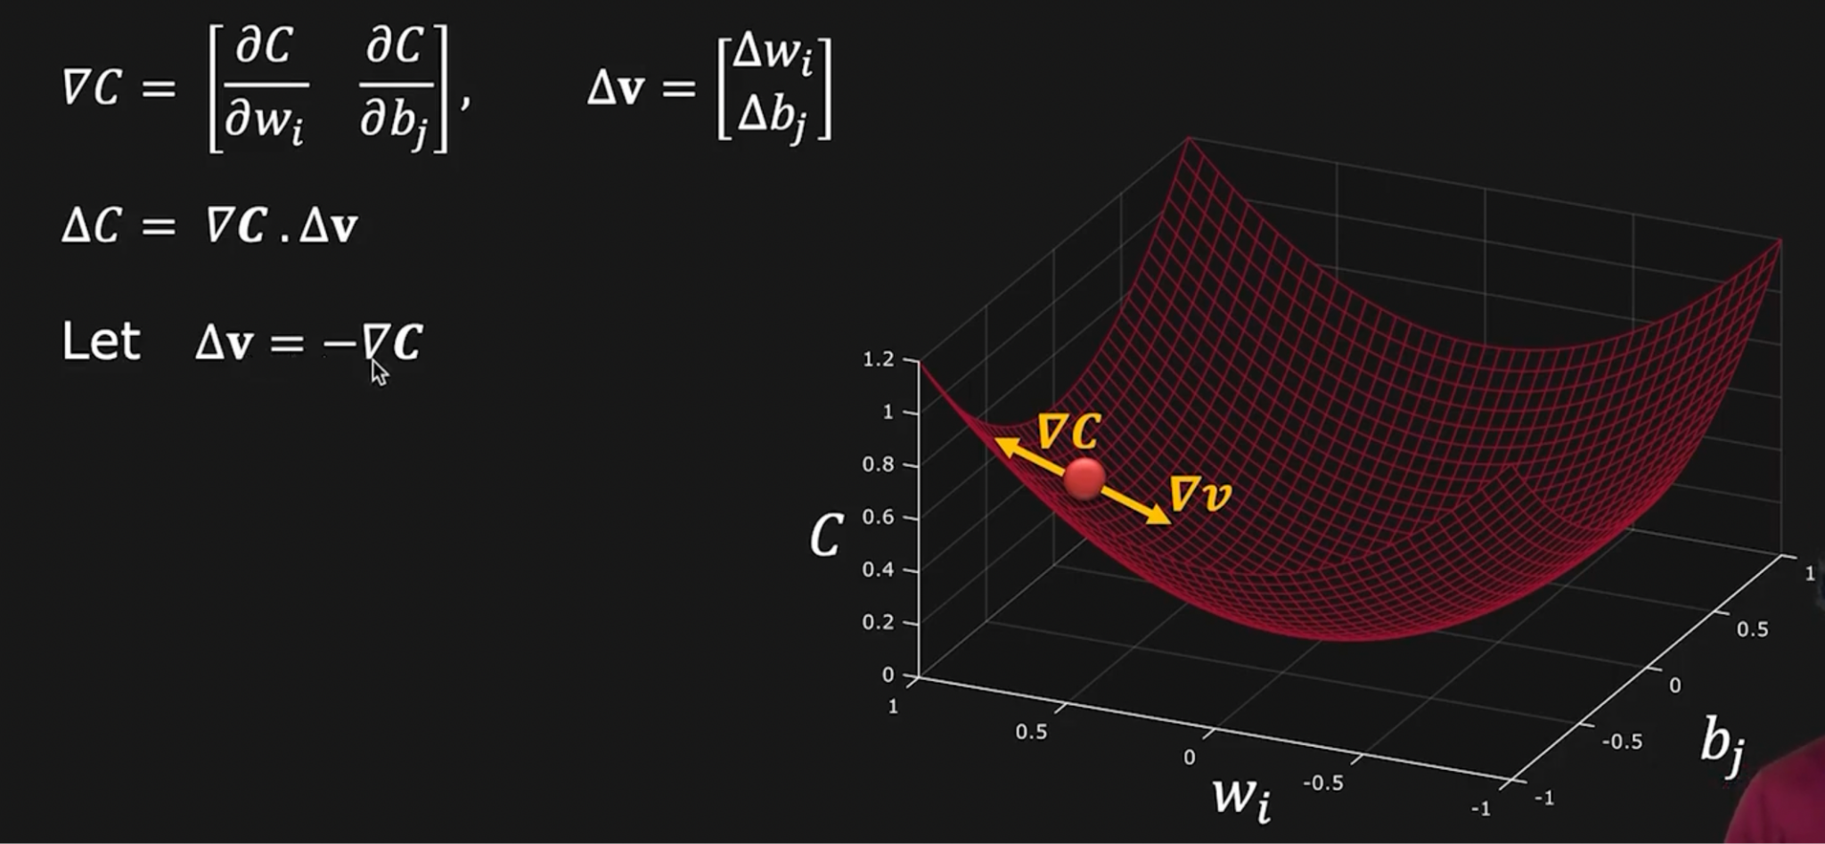
Gradient Descent

Slide 9
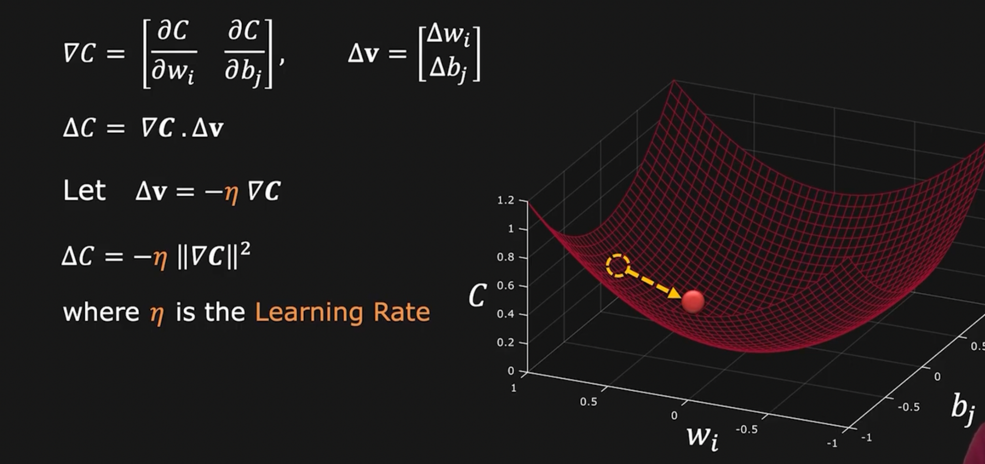
Gradient Descent

Slide 10
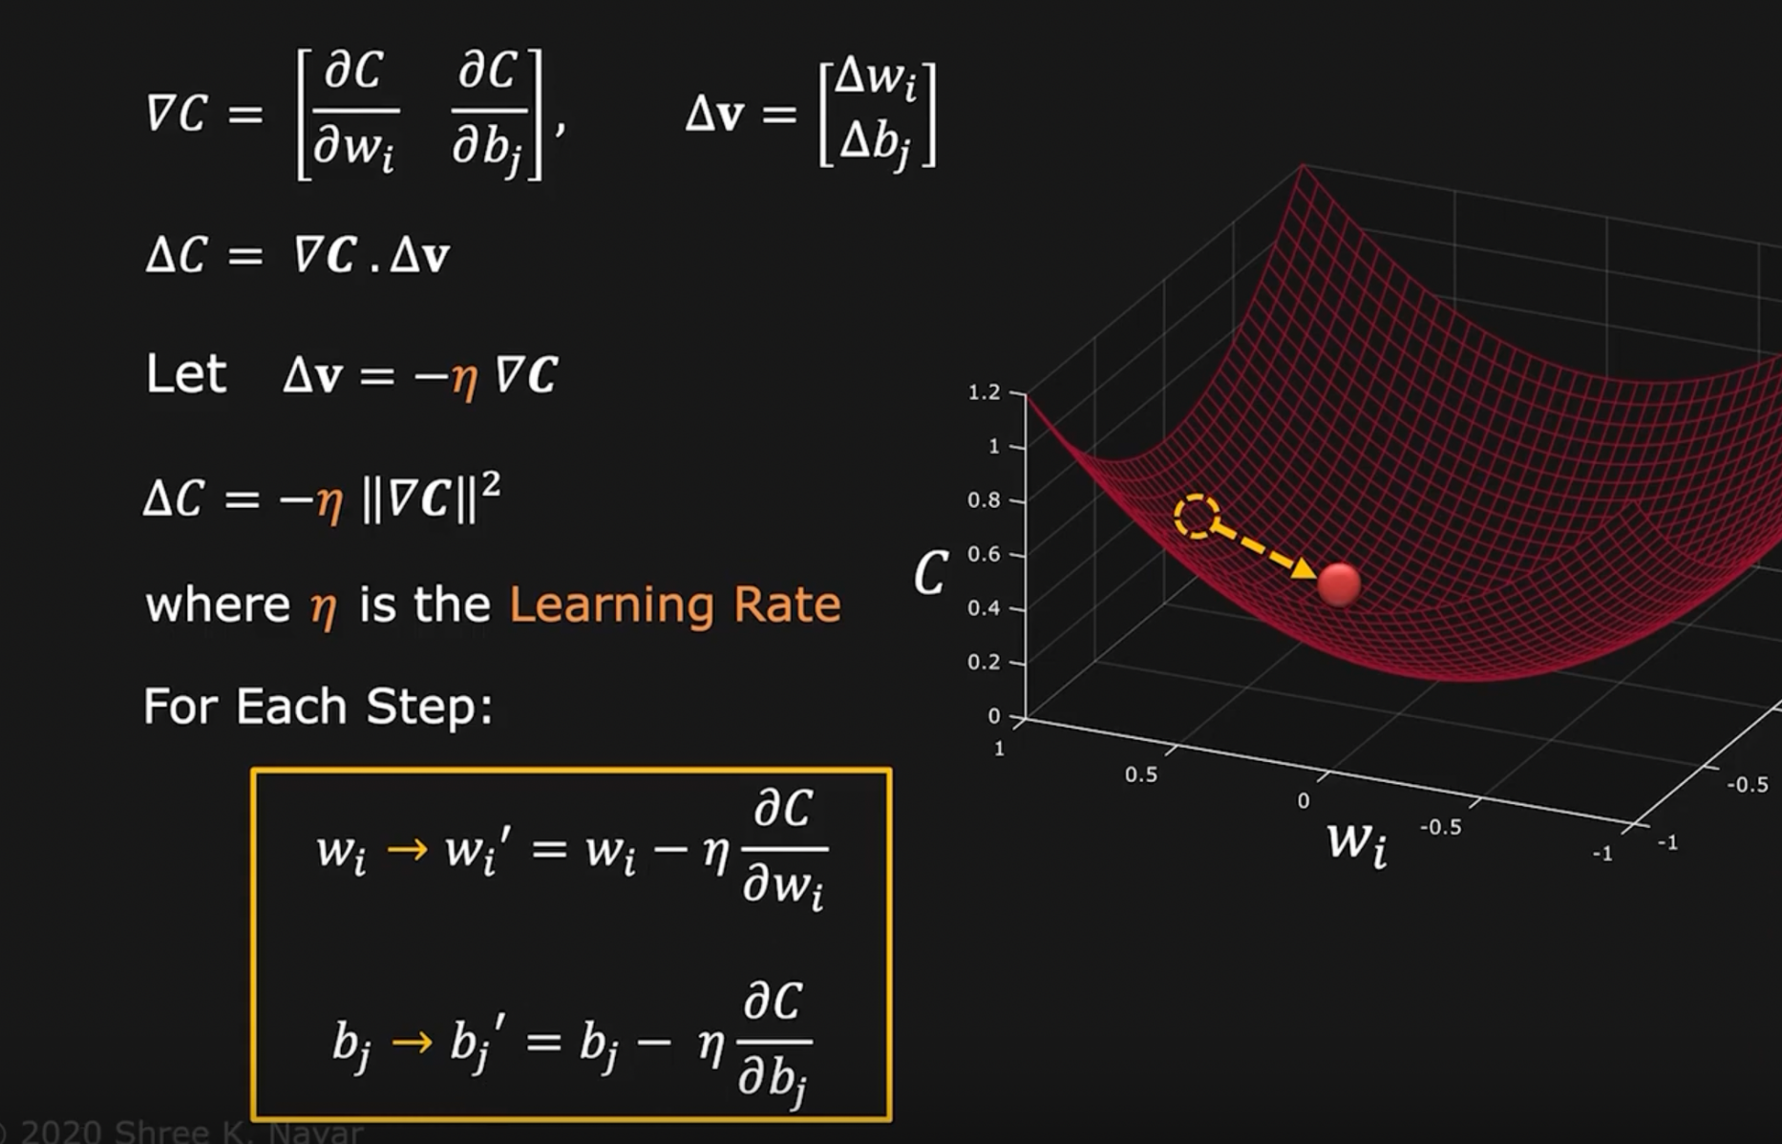
Gradient Descent

Slide 11
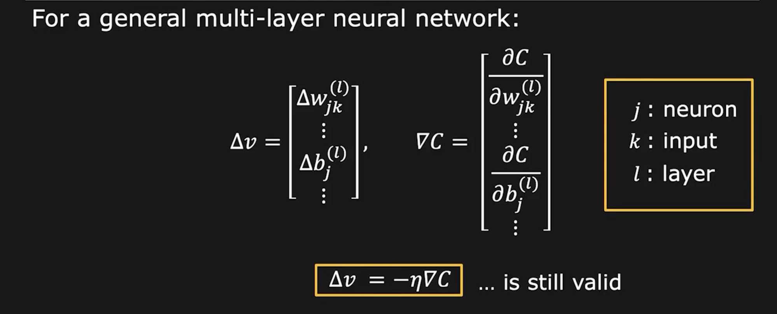
Gradient Descent

Slide 12
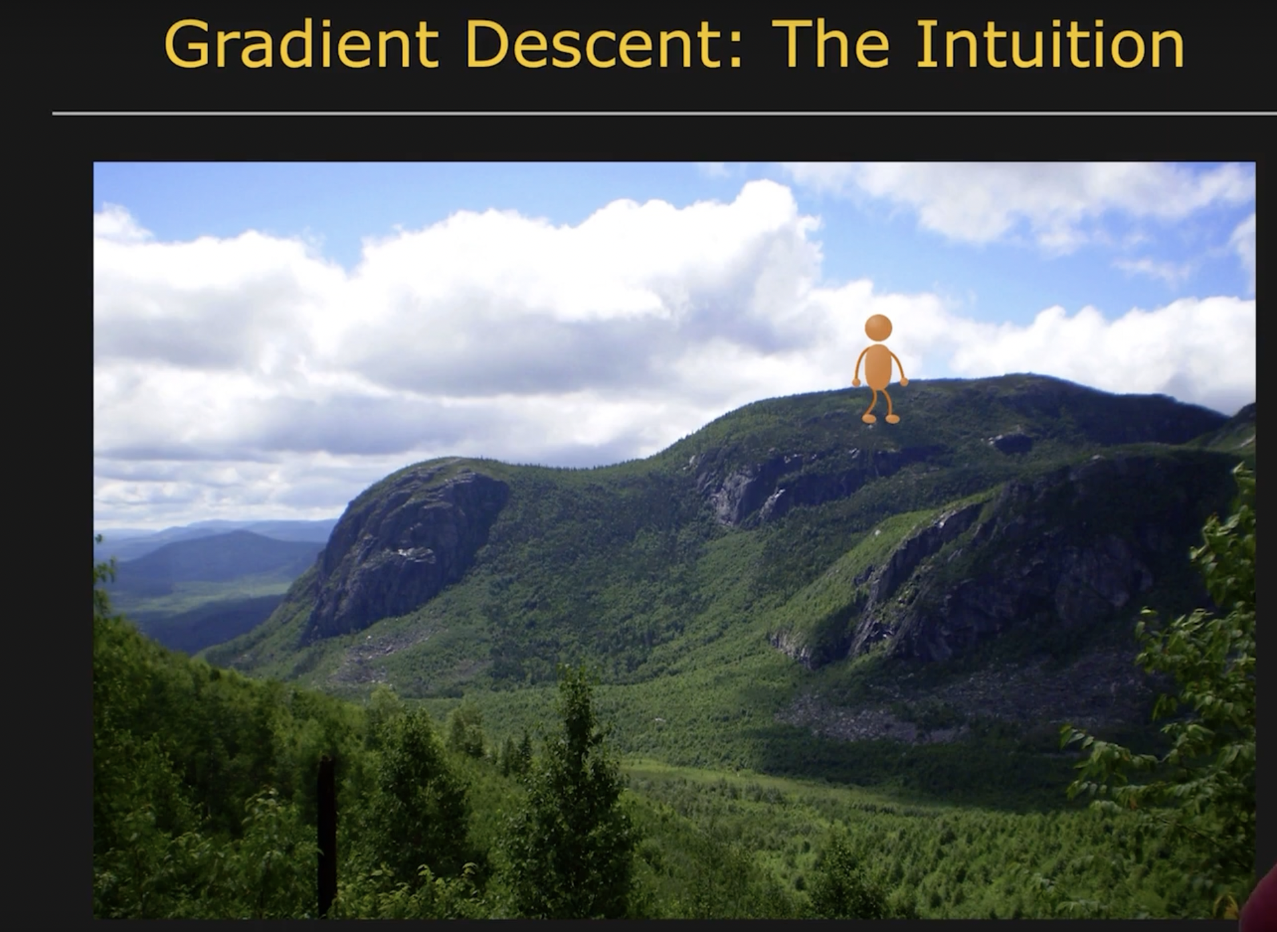
Gradient Descent

Slide 13
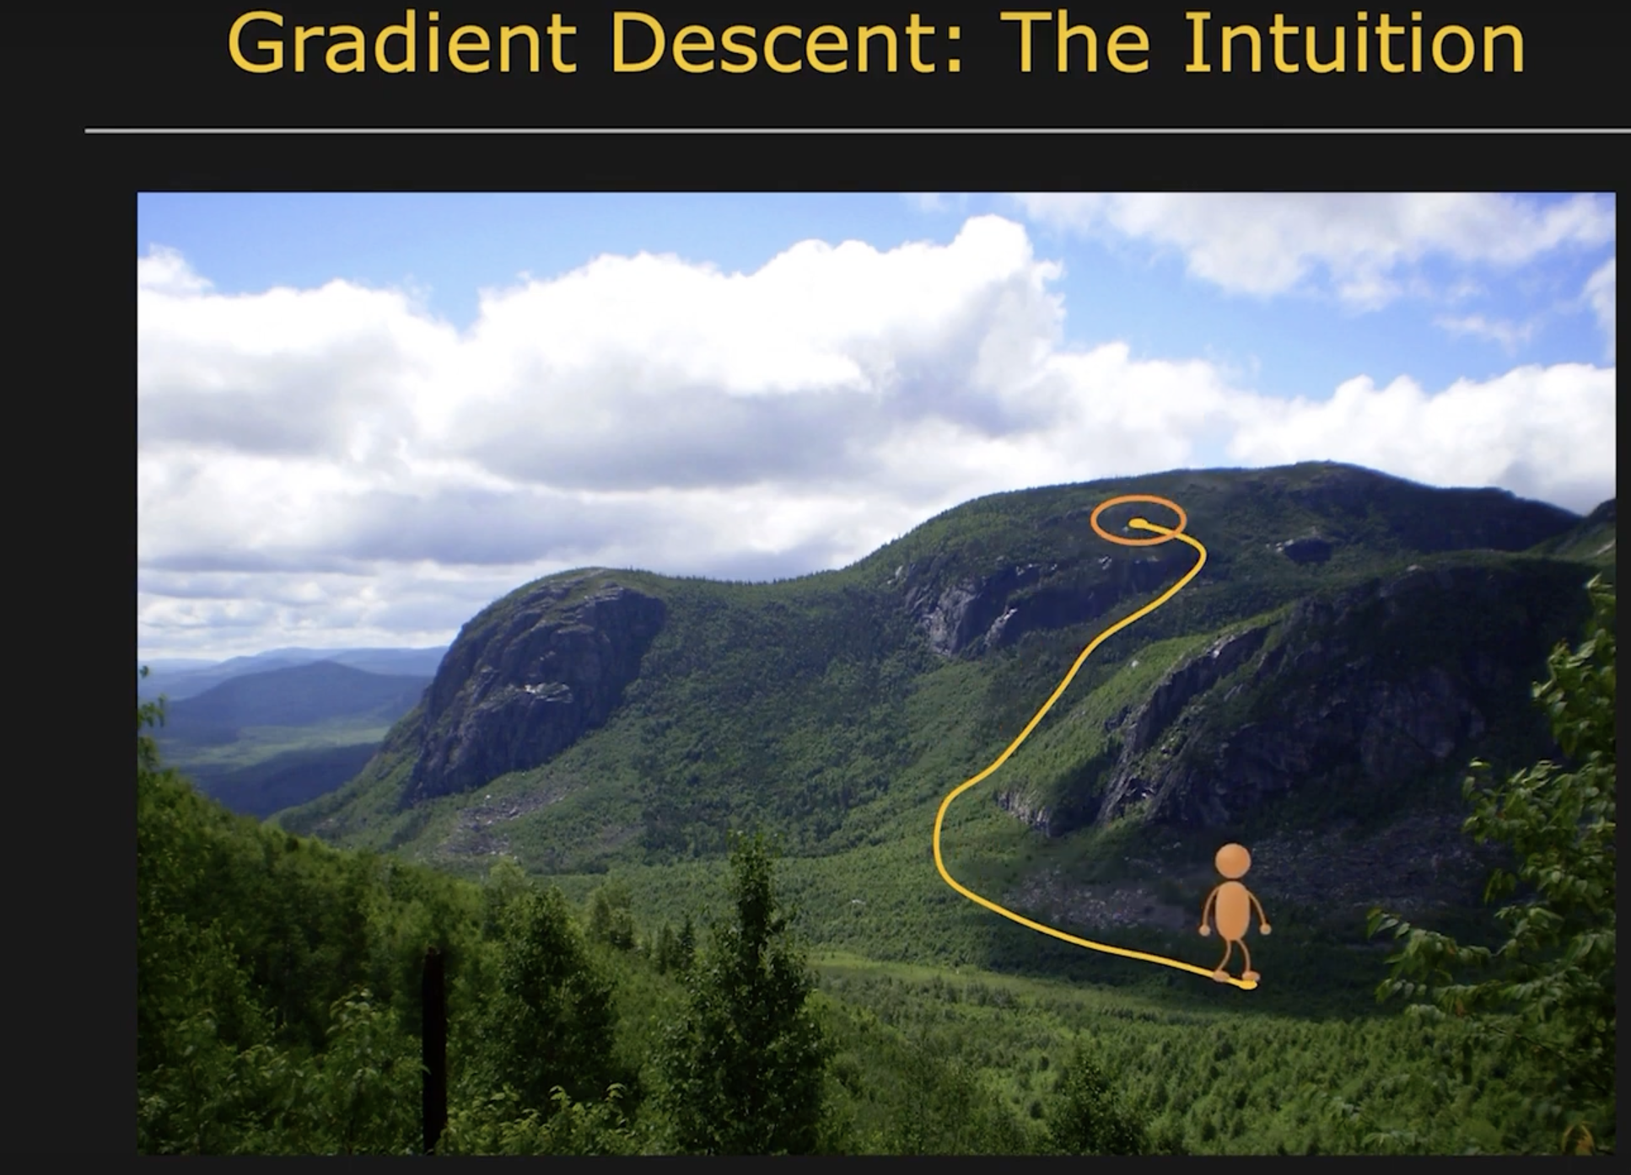
Gradient Descent

Slide 14
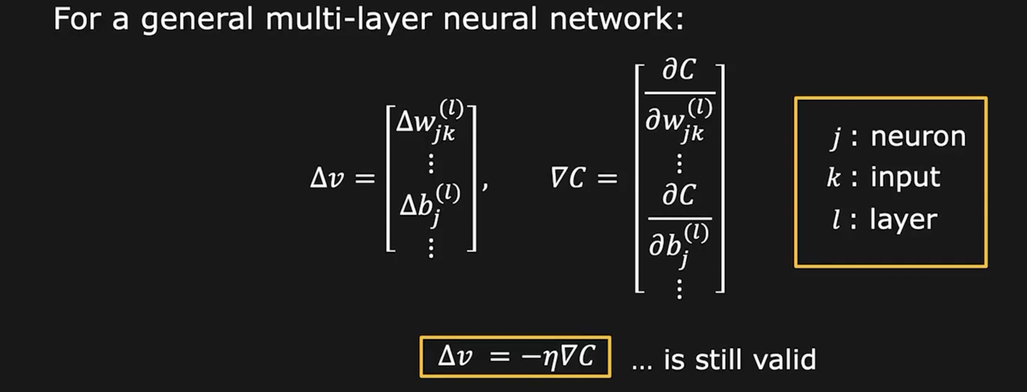
Gradient Descent for the entire network

Slide 15
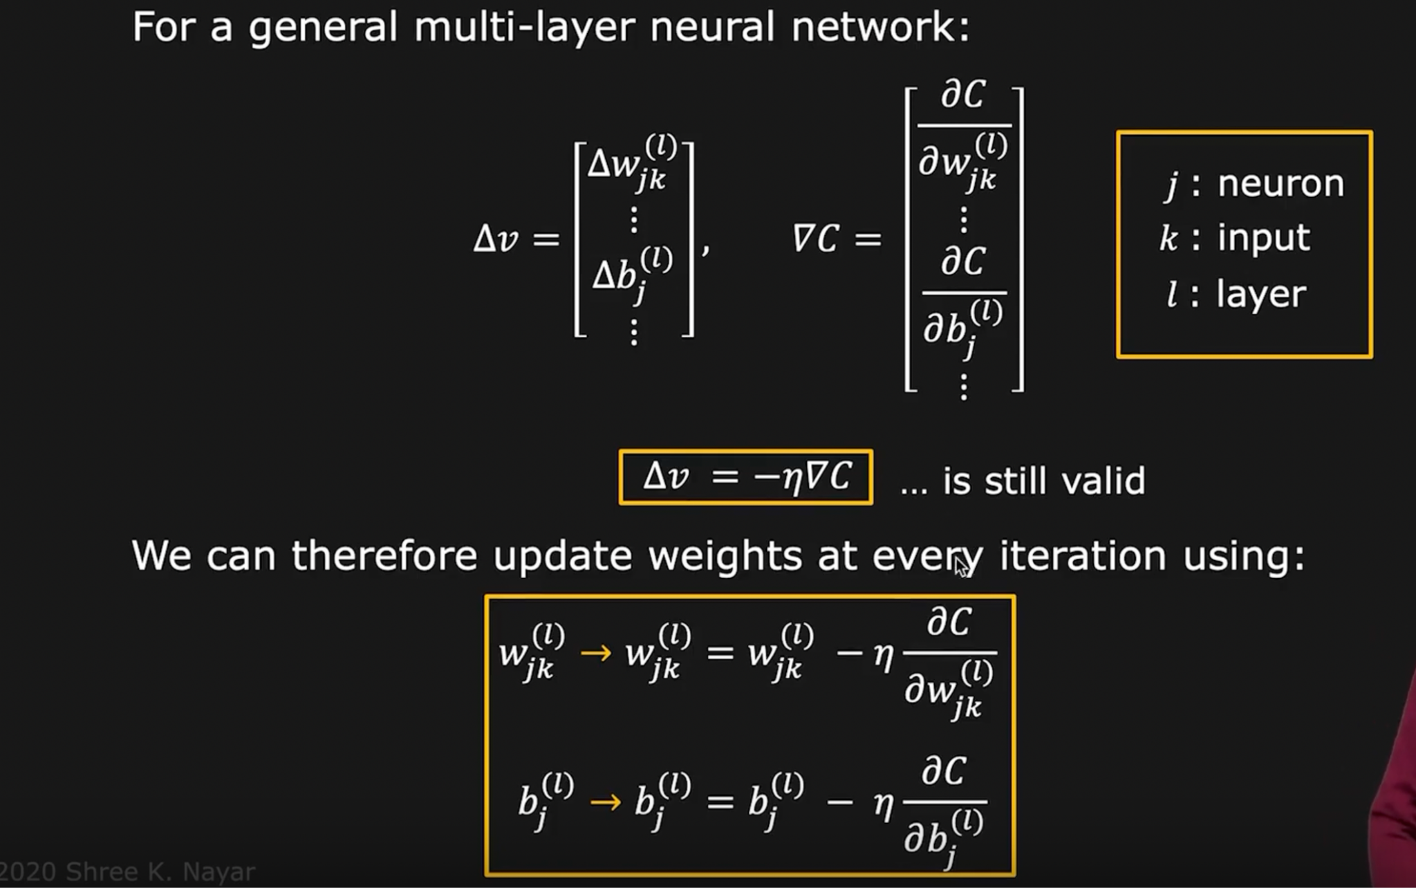
Gradient Descent for the Entire Network
11111111111111111

Slide 16
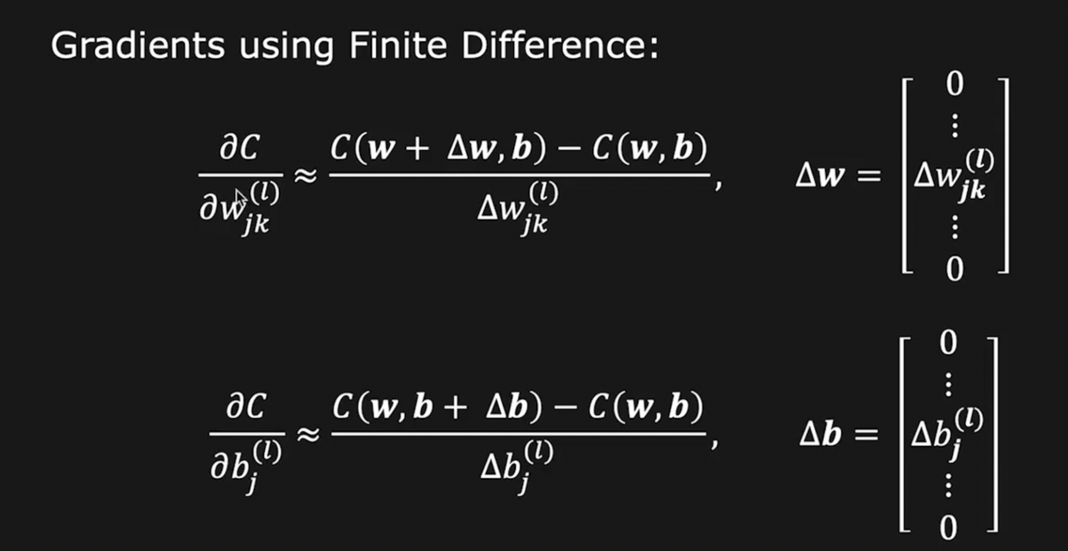
Gradient Computation

Slide 17
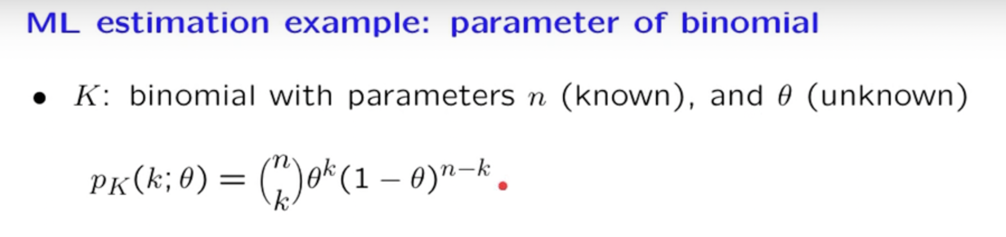
Maximum Likelihood Estimation (MLE)

Slide 18
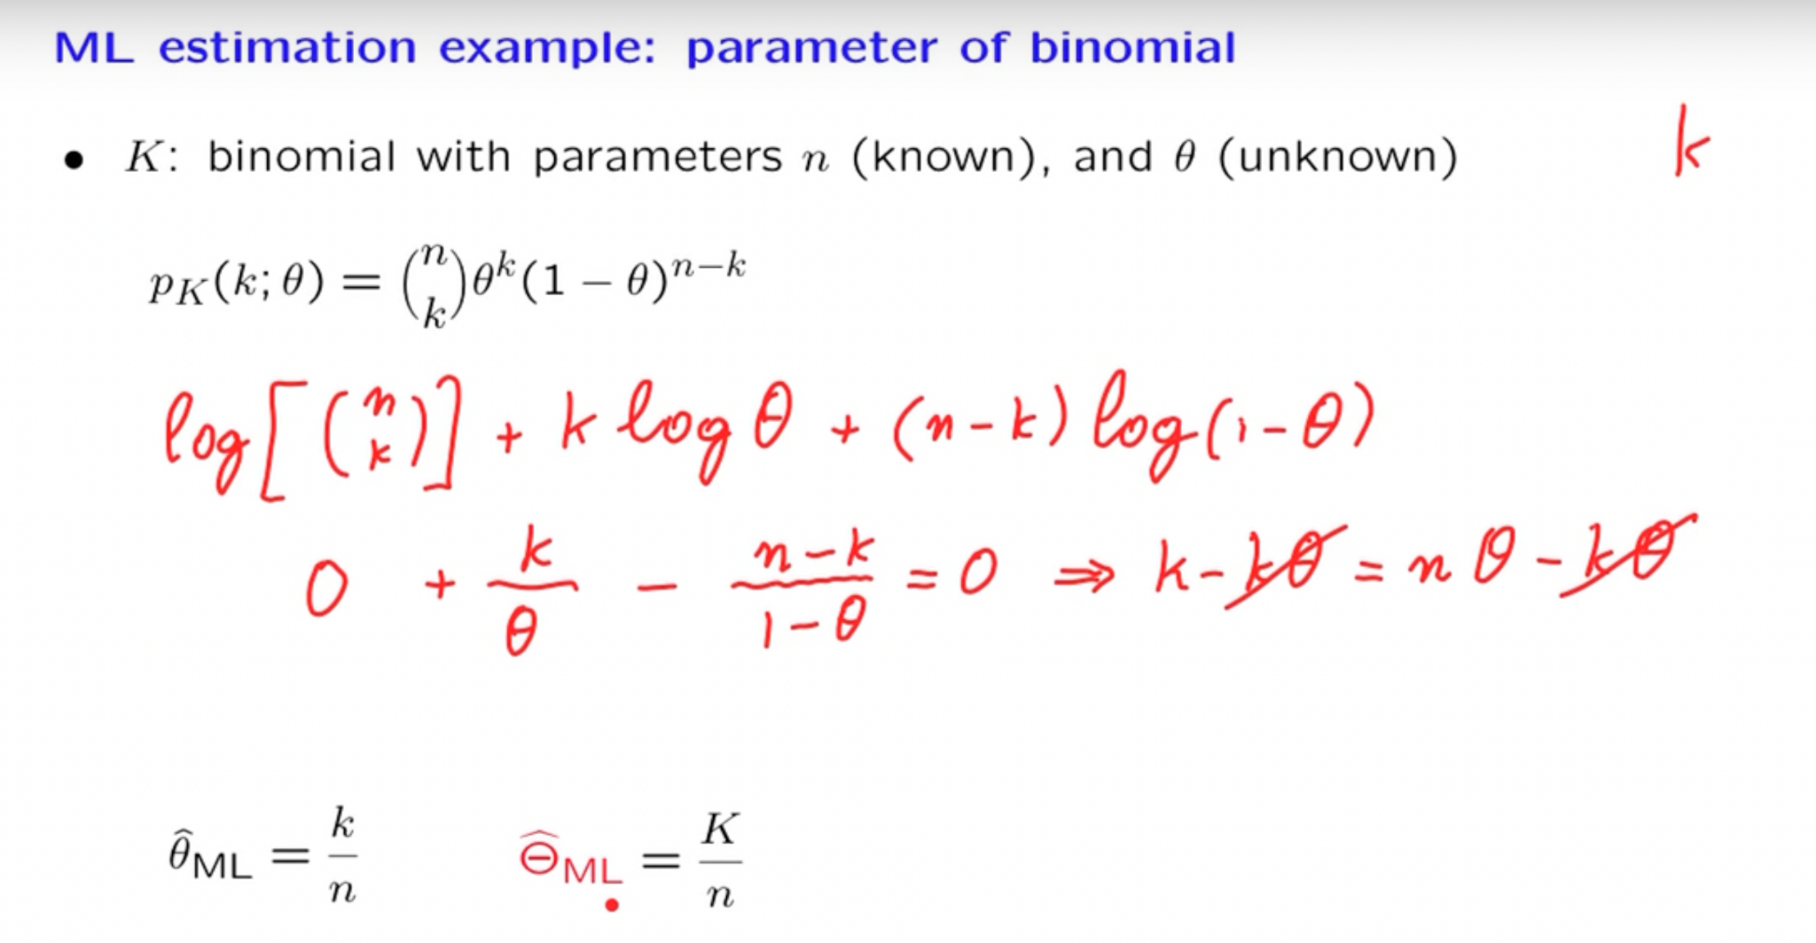
Maximum Likelihood Estimation (MLE)

Slide 19
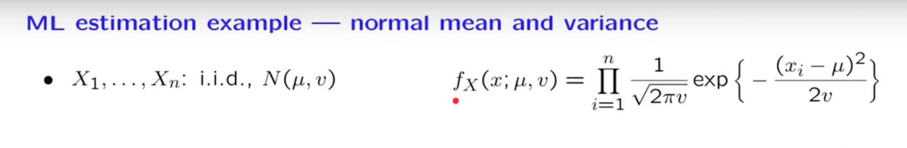
Maximum Likelihood Estimation (MLE)

Slide 20
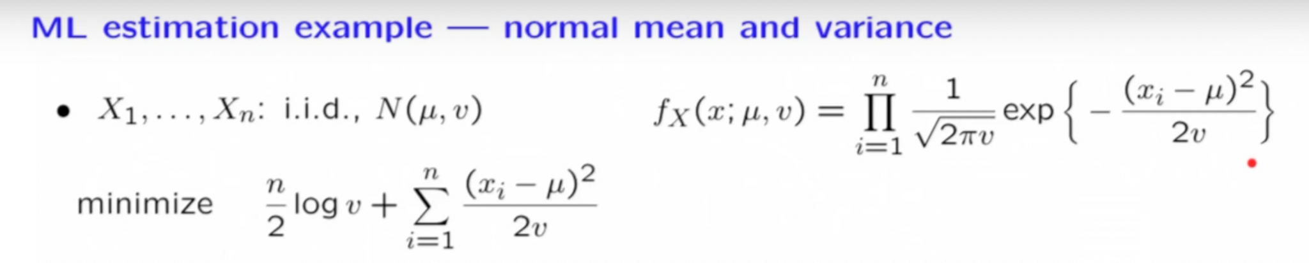
Maximum Likelihood Estimation (MLE)

Slide 21
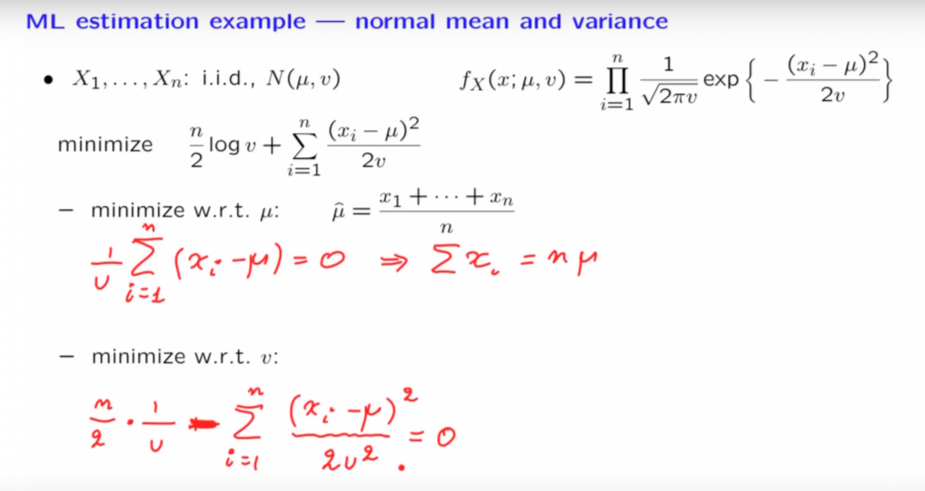
Maximum Likelihood Estimation (MLE)

Slide 22
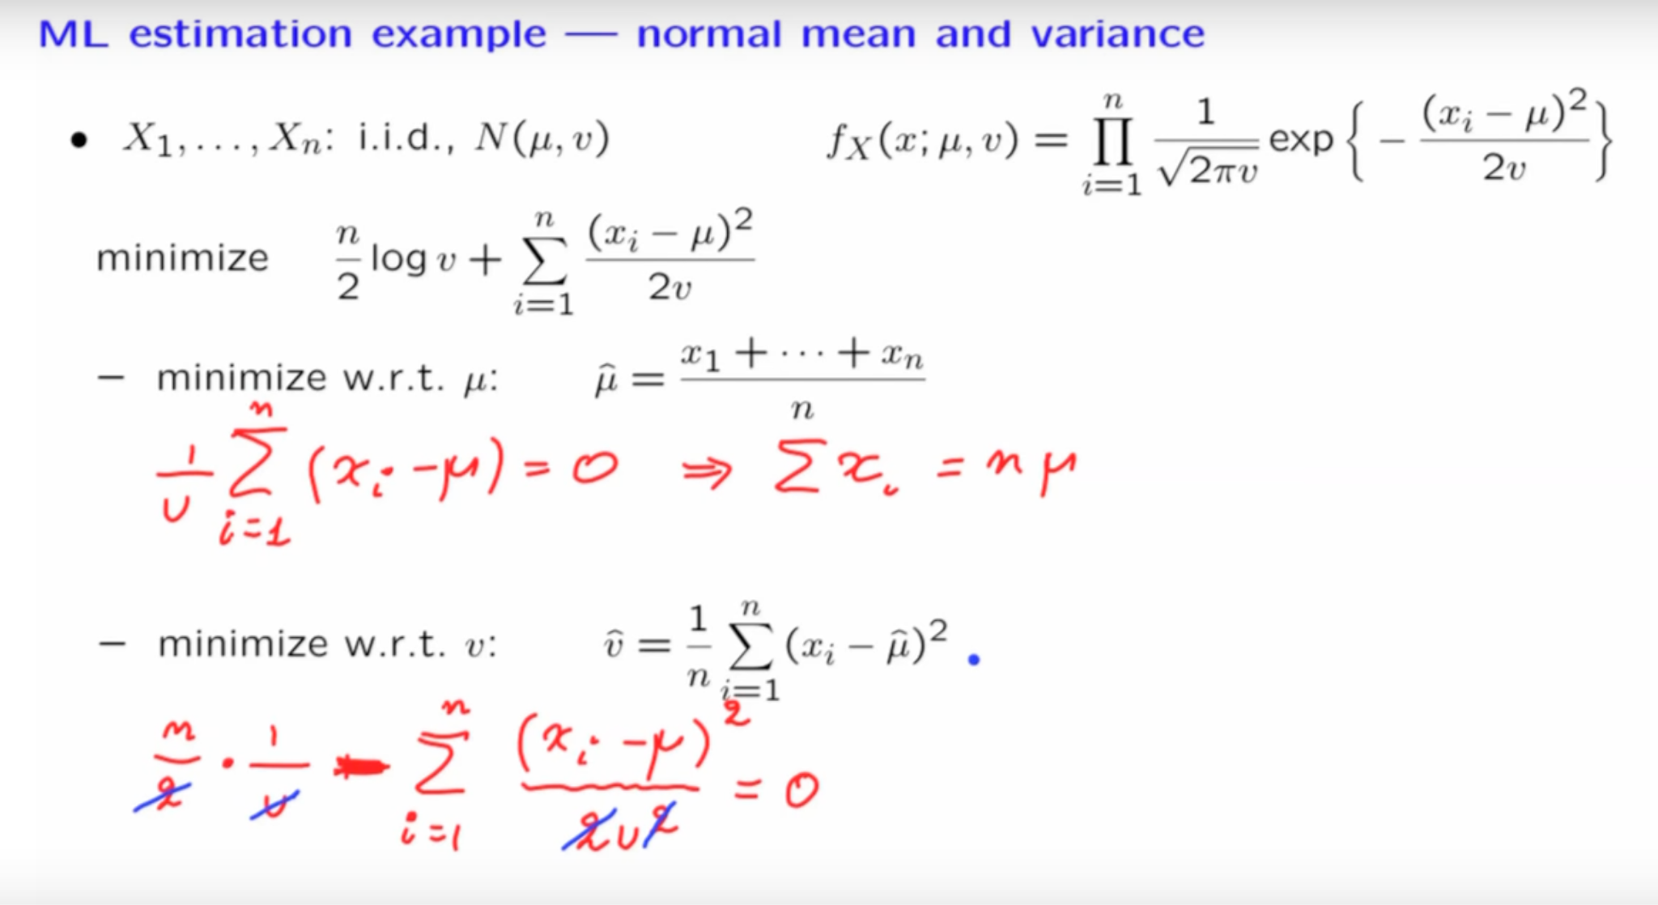
Maximum Likelihood Estimation (MLE)

Slide 23
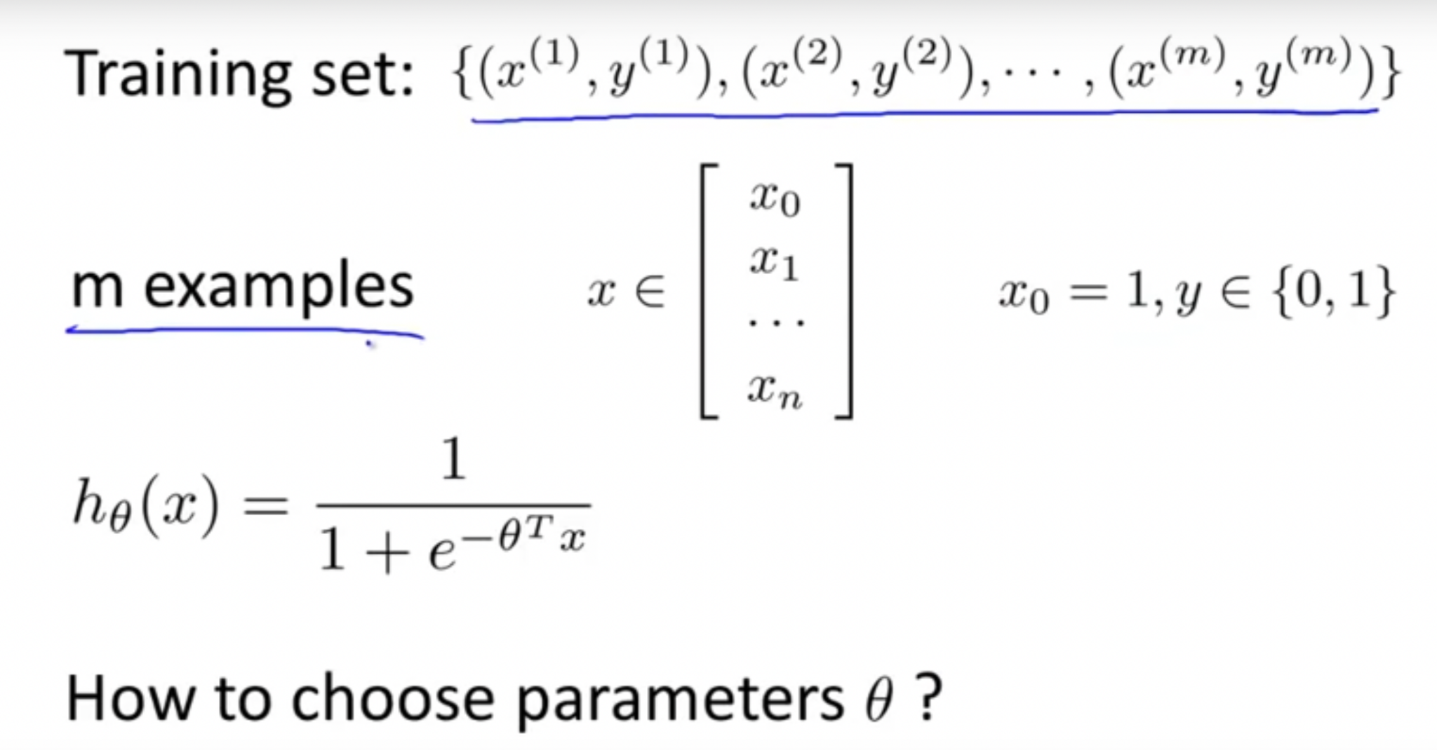
Logistic Regression

Slide 24
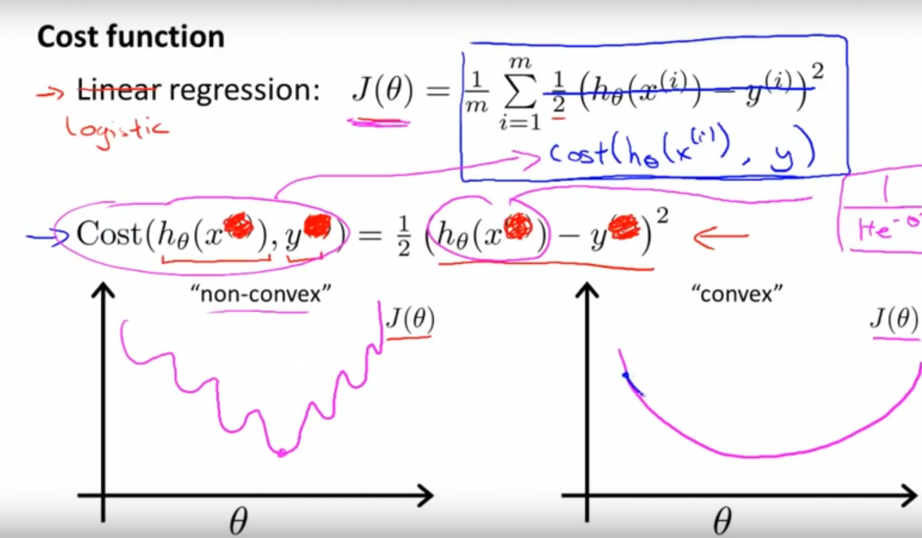
Logistic Regression

Slide 25
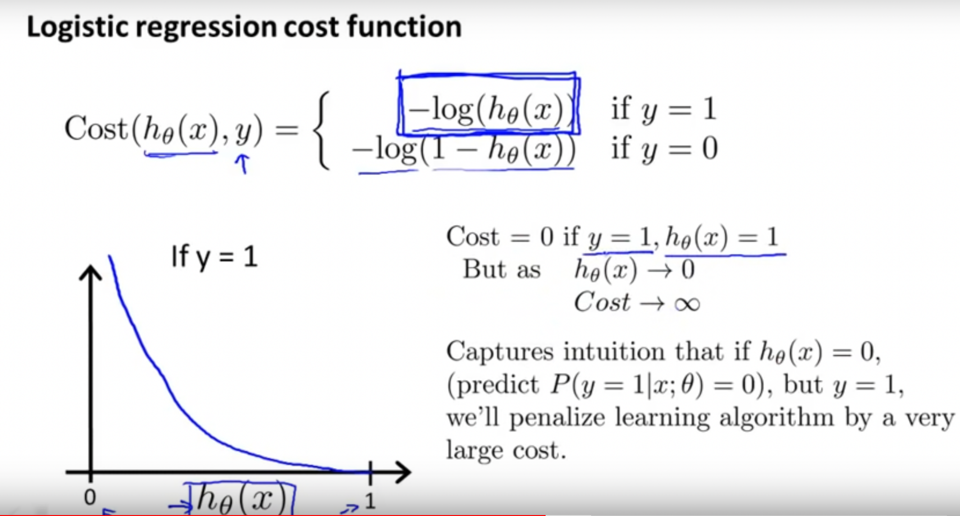
Logistic Regression

Slide 26
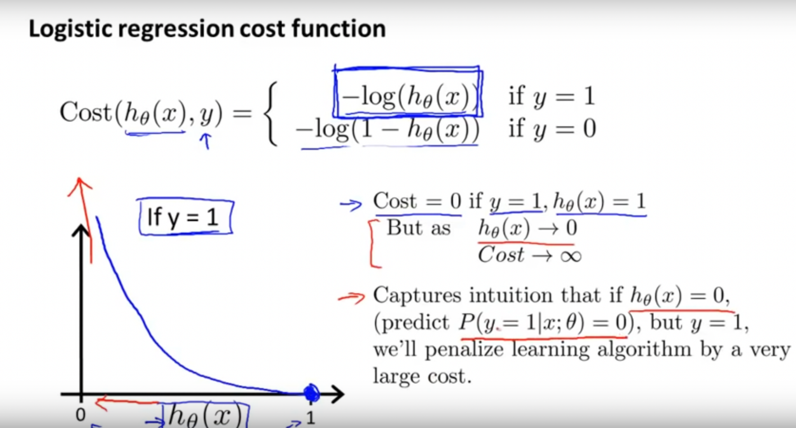
Logistic Regression

Slide 27
Logistic Regression

Slide 28
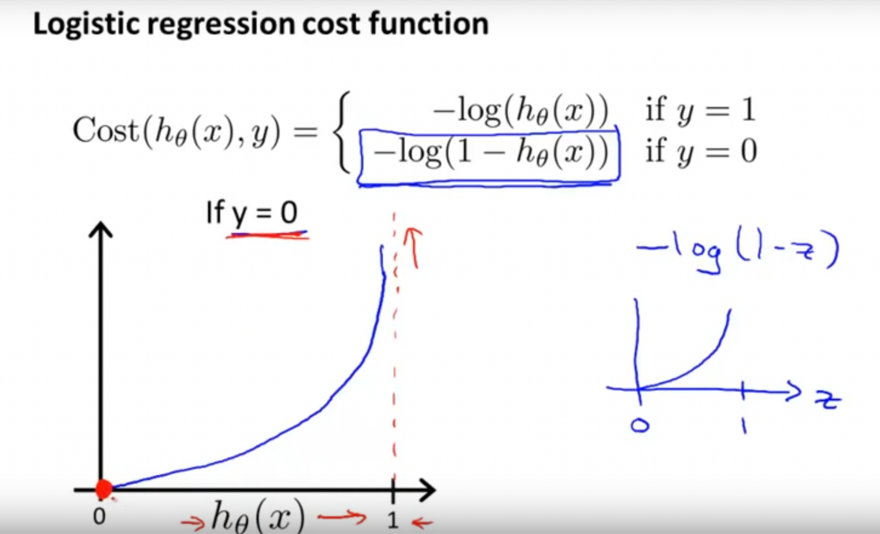
Logistic Regression

Slide 29
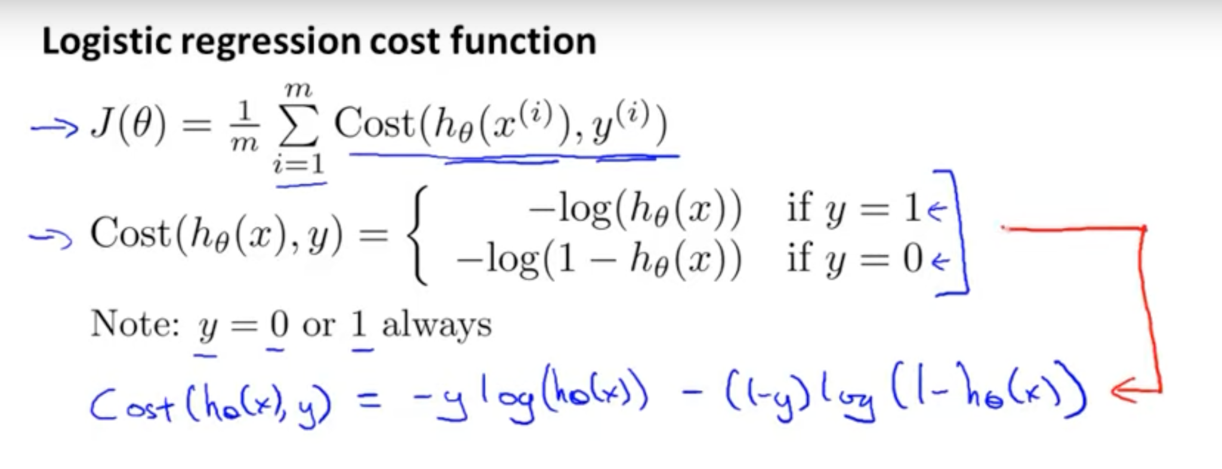
Logistic Regression

Slide 30
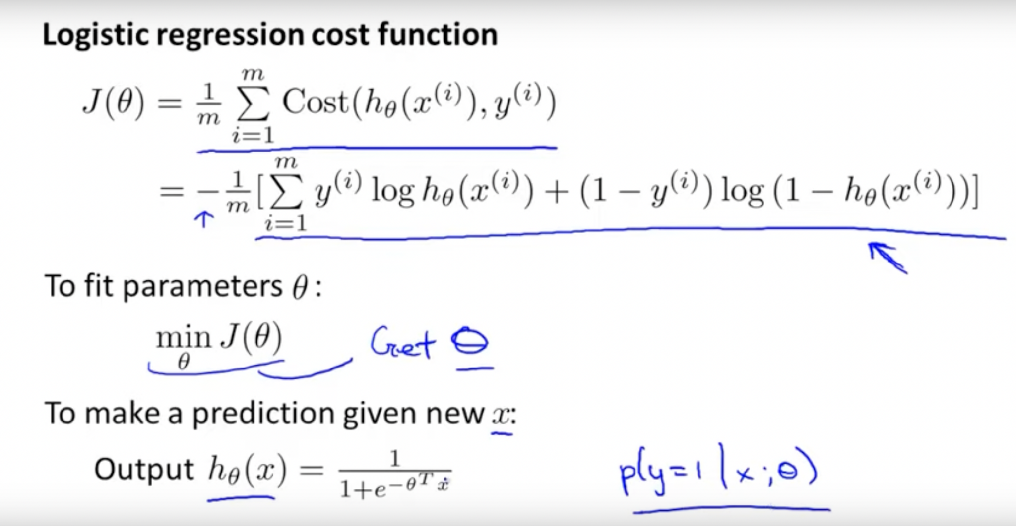
Logistic Regression

Slide 31
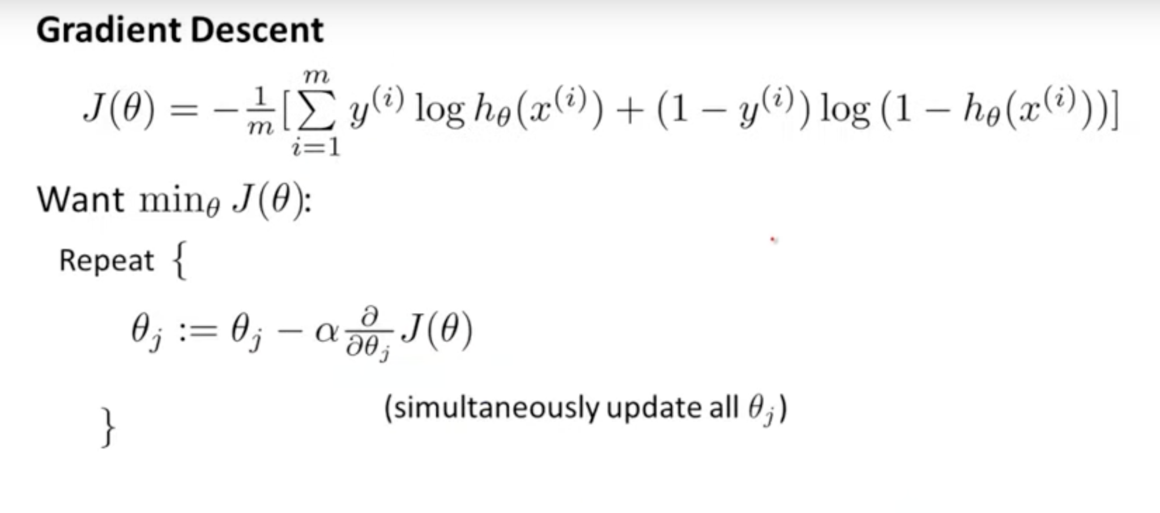
Logistic Regression

Slide 32
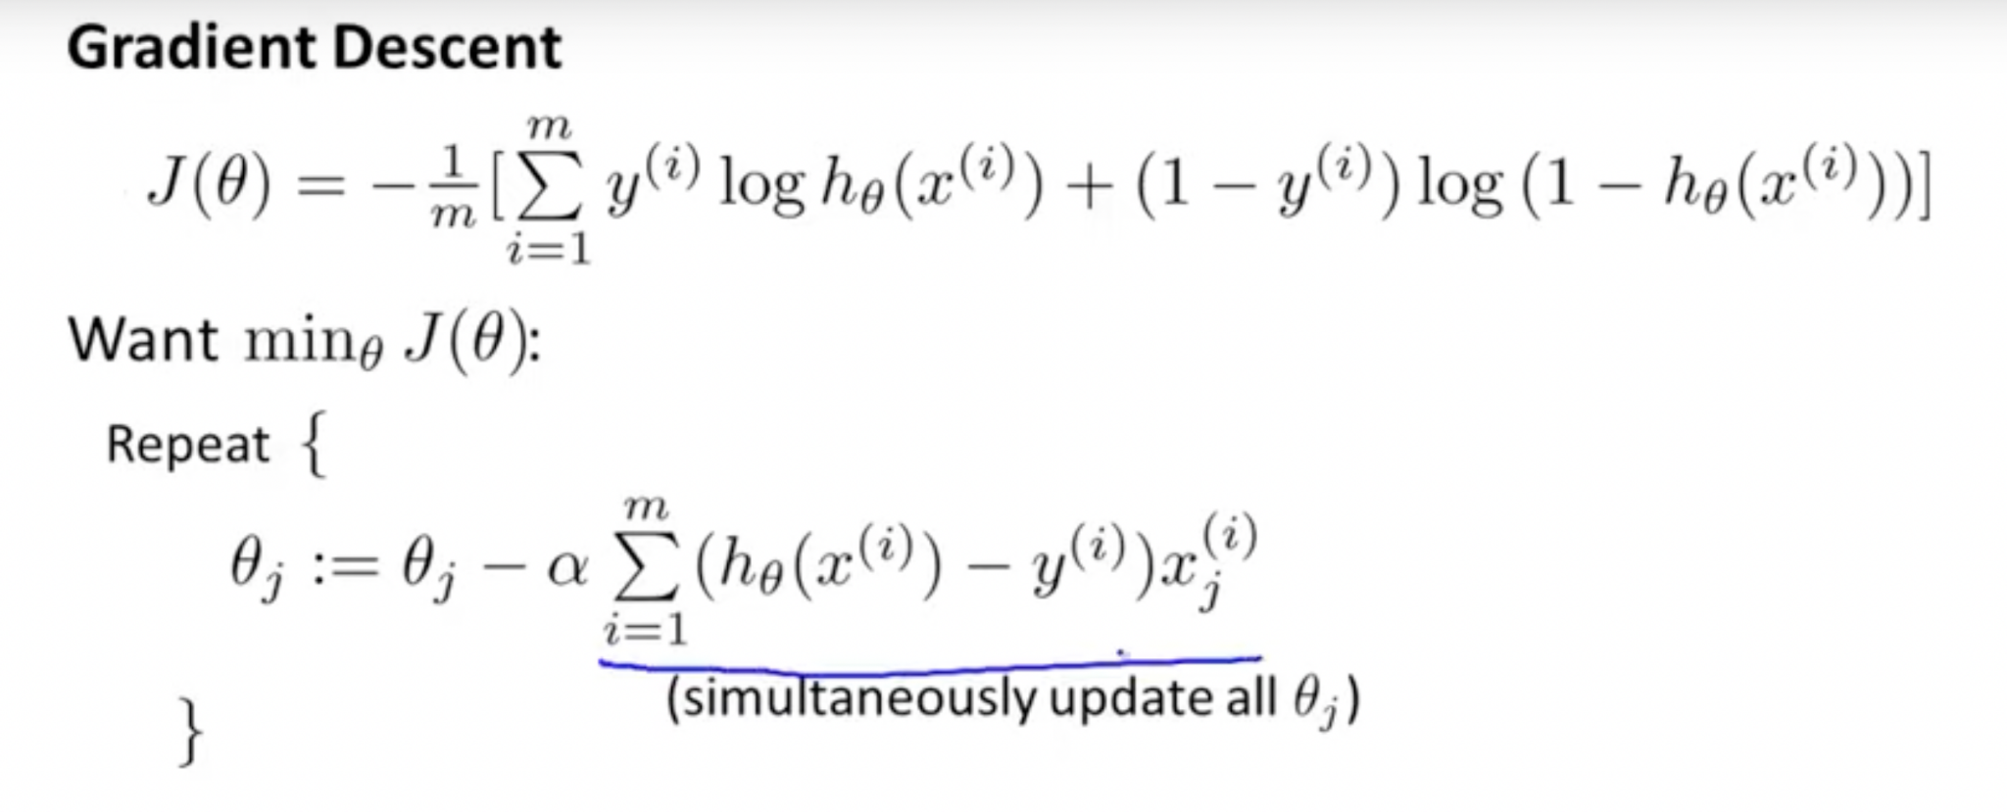
Logistic Regression

